Slide 1
MINDFULNESS IN MODERN LIFE
with Trish Tutton
Notes:
FOCUS
Deepen your understanding of mindfulness beyond the buzzword.
Understand practices to cultivate inner calm in times of change and challenge.
Practice a technique to create an optimistic perspective (so we don't hyper focus on the negative during times of stress).
Learn how multitasking increases your stress exponentially and a simple method to be more focused and less distracted.
Create an action plan (supported by behaviour change science) to integrate mindfulness into your life practically and easily.
Be inspired to take small daily actions to increase your mindfulness habit.
Opportunity for Q+A.

Slide 2
Before today, have you heard the word mindfulness?

Slide 3
Could you confidently define the word mindfulness?

Slide 4
Do you regularly practice mindfulness?

Slide 5
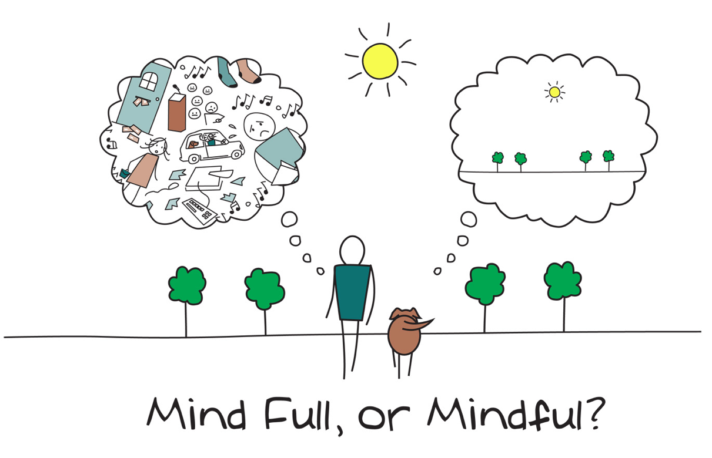

Slide 6

Mindfulness
A mental state of being in the present moment with acceptance.

Slide 7
When do you already experience moments of mindfulness?
Notes:
WORKBOOK

Slide 8

MINDFULNESS,
REDUCES THE STRESSOR OF
MULTI-TASKING
Notes:
While a very common way that a lot of us move through the world - trying to juggle many tasks at once, like our brain is a web browser with 25 tabs open - it not only impairs our productivity by 40% and causes us to make more mistakes but it creates more stress!

Slide 9

"Multitasking is especially stressful
when the tasks are important,
as they often are on the job."
- David Meyer, PhD
Notes:
juggling several tasks also wastes time and reduces work quality, Meyer says.
And it can be very stressful. In the short term, that stress makes you feel lousy. In the long term, it can become a serious threat to health -- negatively affecting our sleep, immune function, relationships, mental, emo and phys health.
How does mindfulness help us reduce multitasking?
Mindfulness is about having our attention in the present moment, on one thing at a time.
So a simple way to practice mindfulness is to focus on one thing at a time.
And it gives us a way to practice the skill.

Slide 10
Just this.
Notes:
Mindfulness is about having our attention in the present moment, on one thing at a time.
So A simple way to practice mindfulness is to focus on one thing at a time.
And it gives us a way to practice the skill.
powerful way to access inner calm

Slide 11

Mindfulness Practice
Enhancing Focus
Notes:
Counting your breath
With practice of this technique our mind learns to focus on one thing at a time - reducing our habit of multitasking - improving productivity, accuracy and reducing stress.
You may have noticed it’s kind of calming! Our minds just like our bodies need rest!
Rest from the barrage of constant thoughts and noise in our heads.

Slide 12
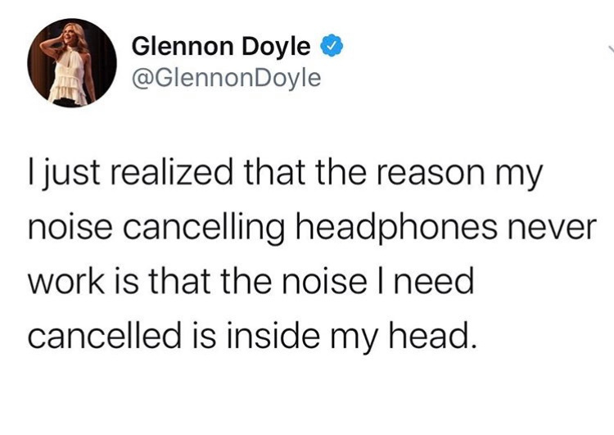
Notes:
And I don’t know about you but I was never taught how to rest my mind other than sleep!
this is a practice of inner calm

Slide 13

MINDFULNESS,
REDUCES THE STRESSOR OF
MULTI-TASKING
PROMOTE OPTIMISM
Notes:
perspective is not what you see - but HOW you see it

Slide 14
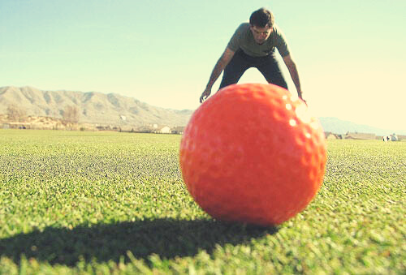
Notes:
imagine the golf ball is the latest challenge / or problem you've encountered.
for many of us it’s all we think about, talk about, dream about – it gets exaggerated because of our perspective.
We shoot 2nd arrows which exaggerates it too!
our problems can take up so much mental space we get stuck in a negative perspective and can't see the good!

Slide 15


NEGATIVITY BIAS
Notes:
we also get stuck in our negativity bias
mind wanders 47% of the time harvard study
2/3 of the time it thinks of negative outcomes
we can get stuck in neg. perspective and not be able to see the good

Slide 16

The power of perspective.
Notes:
we can miss out on the beauty and the good that still exists in life.
experiments illustrate this – years ago world class violinist joshua bell took his violin to the subways of new York ...
we can train ourselves to become more present - to see the big picture

Slide 17

Notes:
part of self-care is about see reality as it is - the big picture – not WORSE not BETTER see them exactly as they are – clearly – equanimity:
The ability to acknowledge our challenges AND see the big picture.
Really about mindset. Which is something we have control over.

Slide 18
Mindfulness Practice
Savour the good
Notes:
Sit or lie comfortably
Close your eyes
Direct your attention on your breath for a few rounds of inhales and exhales.
Begin to bring your attention to something you are grateful or appreciative for (a person, a thing, a quality about yourself, an experience.)
Notice the feelings that arise when you consider your appreciation. Feel it in your body.
Imagine that this feeling could expand. As you breath the pleasant feeling radiates through your body through every cell.
Imagine you could soak up this pleasant feeling like a sponge.

Slide 19
Long term meditation can quiet the amygdala - responsible for sensing threat and worry.
Source: Scientific American Blog, "What Does Mindfulness Meditation Do to Your Brain?", 2014

Slide 20
In a positive brain state we are:
  more energetic, creative, intelligent
  31% more productive
  37% better at sales
  doctors 19% faster with correct diagnosis
Source: Shawn Achor, The Happiness Advantage, 2010

Slide 21
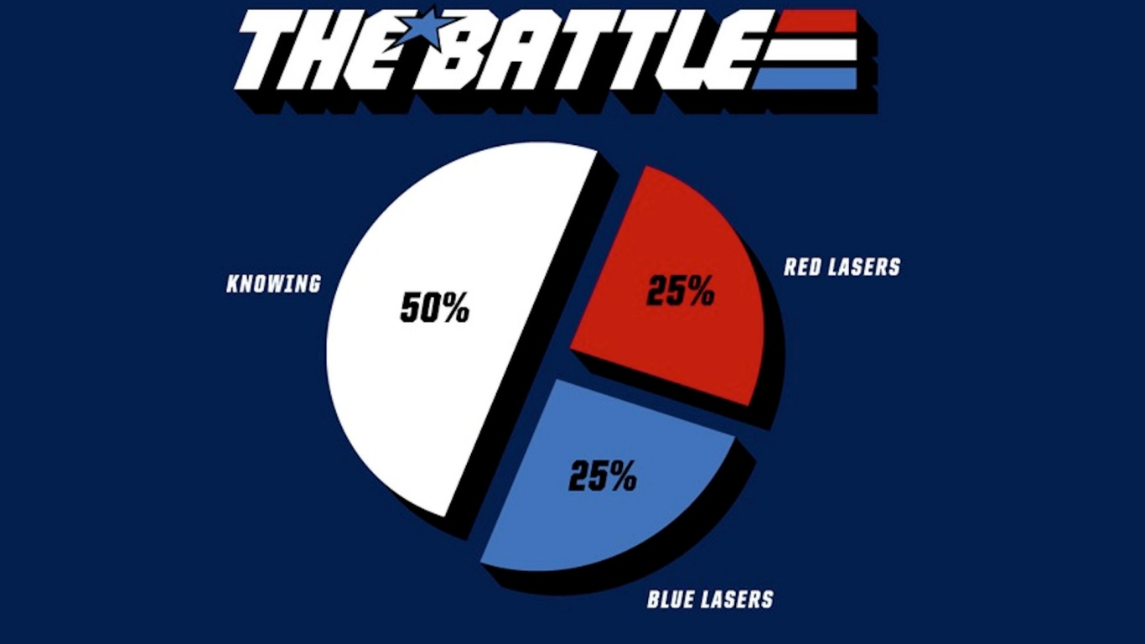

Slide 22

CREATE A HABIT
START SMALL

Slide 23

CREATE A HABIT
START SMALL
WRITE A RECIPE FOR A HABIT

Slide 24
CREATE A HABIT
I will HABIT in LOCATION at TIME
"I will (share with my family 5 things I'm grateful for) in (the kitchen) at (dinner time)"

Slide 25
CREATE A HABIT
I will HABIT in LOCATION at TIME
"I will (focus on my breath for 1 min) in (the office) (before I open my emails)"

Slide 26
CREATE A HABIT
I will HABIT in LOCATION at TIME
"I will do (One minute of “Just, this”) in (my bedroom)
at (7am when I wake up) "

Slide 27

CREATE A HABIT
START SMALL
WRITE A RECIPE FOR A HABIT
TOLERATE AND PLAN FOR FAILURE

Slide 28


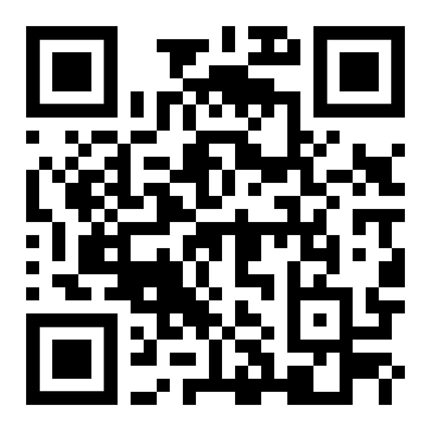
LET'S STAY CONNECTED
@trish_tutton
Scan the QR code for my free download,
"Start your day with calm"

Slide 29

Mindfulness won’t change the world, but will change YOU.

